Slide 1
Review Session 1

Slide 2
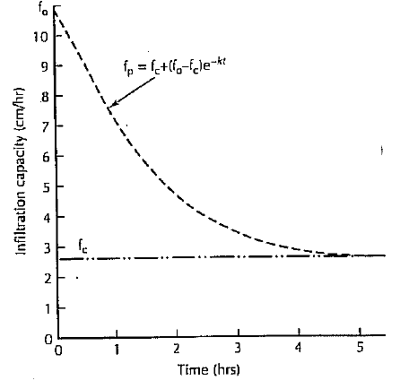
Events during Precipitation - Infiltration
Not all water that falls will reach the water table
Infiltration Capacity is measure of a soils capacity to absorb water
Highly variable – soil type, but also the same soil varies depending on current moisture content
Horton Infiltration Capacity Equation

Slide 3
Example
Consider the following rain event
25mm/hr for 1st hour
50 mm/hr during 2nd hour
10 mm/hr for 3rd hour
How much infiltration will happen into a soil with the following Horton infiltration capacity parameters
fc=20 mm/hr
fo=80 mm/hr
k=3/4

Slide 4
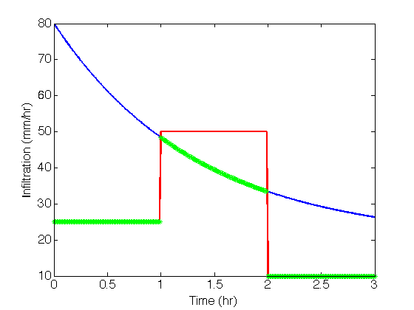
Plot Precipitation and Infiltration Capacity against time

Slide 5
Find minimum across each interval

Slide 6
Perform Calculation

Slide 7
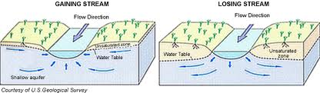
Streams and Groundwater Gaining vs Losing
How do you determine which it is? – Groups

Slide 8
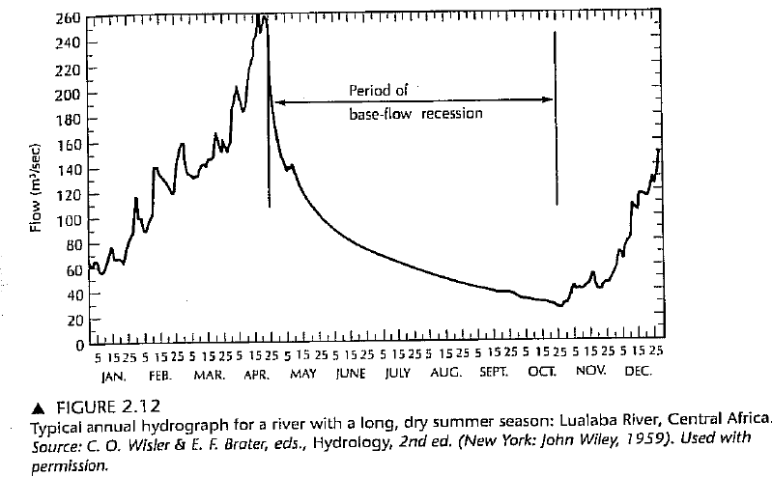
Stream Hydrographs – Baseflow Recessions
Baseflow is is the portion of streamflow that comes from subsurface flow
Baseflow recession in a stream occurs when groundwater feed to a stream decreases

Slide 9
Stream Hydrographs – Baseflow Recessions
Complex thing that depends on lots of characteristics in a watershed (topography, drainage, soils +geology)… but often the equation is simple
a is a constant for a given river and will not change from year to year unless there has been some dramatic events that have changed the local hydrology
(same goes for t₁, which is an indirect measure of a, in the following examples)

Slide 10
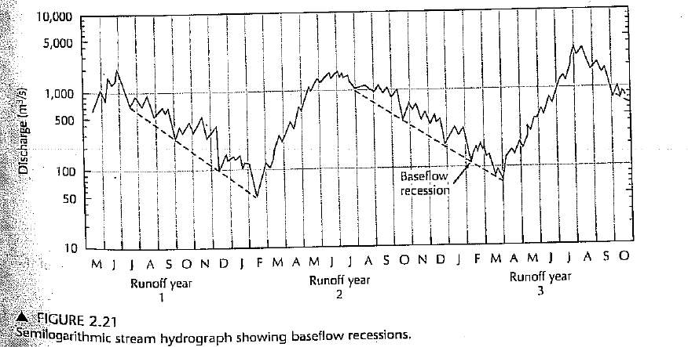
Determining Ground-Water Recharge from Baseflow
Seasonal Recession Method
Find time t₁ when Q=Q₀/10
Find V_{tp,} the volume of potential gw discharge
Calculate potential baseflow at t, the end of the recession
Recharge= V_{tp}(next season)- V_{t}(season 1)
Apply algorithm to this figure

Slide 11
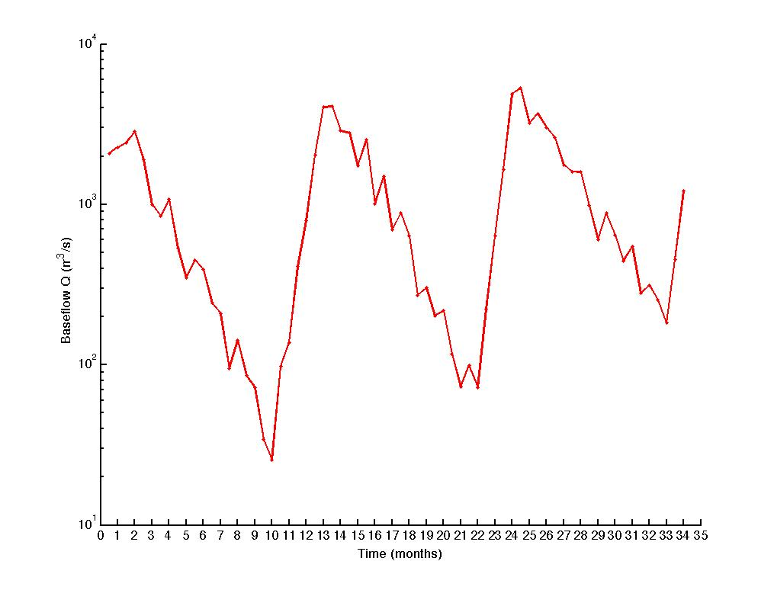
Example
Compute the volume of annual recharge that occurs between runoff year 1 and 2

Slide 12
Step a - Find time t₁ when Q=Q₀/10
Q₀⁽¹⁾=3000
Q₀⁽¹⁾=3000
Q₀⁽¹⁾/10=300
t₁=(6-2)=4
t₁

Slide 13
Step a - Find time t₁ when Q=Q₀/10
Q₀⁽¹⁾=3000 m³/s
t₁=4 months
t₁

Slide 14
Step a - Find time t₁ when Q=Q₀/10
Q₀⁽²⁾=4000 m³/s
Q₀⁽²⁾=4000 m³/s
t₁

Slide 15
(c) Calculate potential baseflow at t, the end of the recession
t=(10-2)=8 months
t
t₁

Slide 16
Final step calculate recharge
Recharge= V_{tp}(next season)- V_{t}(season 1)

Slide 17
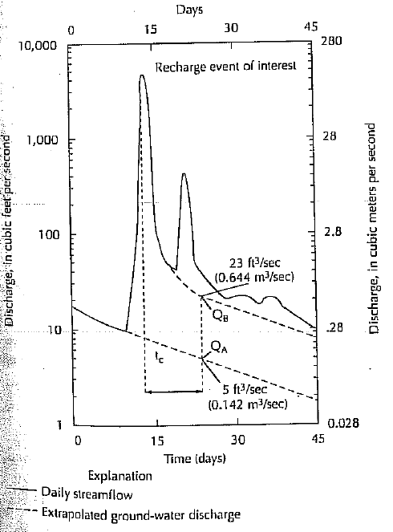
Determining Ground-Water Recharge from Baseflow
Recession Curve Displacement
Find t₁
Compute t_{c}=0.2144t₁
Locate time t_{c} after peak
Extrapolate recession A and B to find Q_{A} and Q_{B} at t_{c}
Apply equation

Slide 18
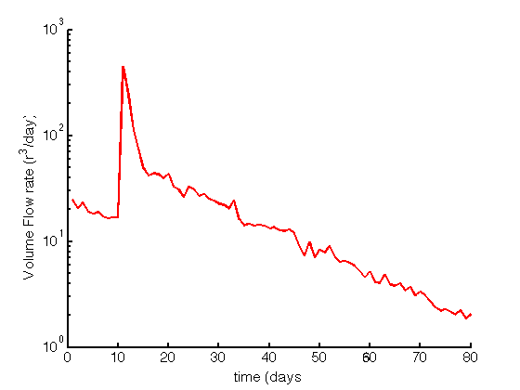
Example
Q (m³/s)

Slide 19
Step 1 – find t₁
Extrapolate lower curve out over all times
Pick any point on this curve
Q₀=20 on day 3
Q₀/10=2
Q (m³/s)
t₁=62-3=59 days
t₁

Slide 20
Step 2 – Compute t_{c}=0.2144t₁
Extrapolate lower curve out over all times
Q₀=20 on day 2
Q₀/10=2
Q (m³/s)
t₁=62-3=59 days
t_{c}=0.2144t₁=12.5 days
t₁

Slide 21
Step 3 – Locate time t_{c} after peak
Extrapolate lower curve out over all times
t_{c}
Q₀=20 on day 2
Q₀/10=2
Q (m³/s)
t₁=62-3=59 days
t_{c}=0.2144t₁=12.5 days
t₁

Slide 22
Step 4 – Extrapolate recession A and B to find Q_{A} and Q_{B} at t_{c}
Extrapolate lower curve out over all times
t_{c}
Q_{B}=30m³/s
Q₀=20 on day 2
Q₀/10=2
Q (m³/s)
Q_{A}=9m³/s
t₁=62-3=59 days
t_{c}=0.2144t₁=12.5 days
t₁

Slide 23
Calculate Recharge
Q_{B}=30m³/s
Q_{A}=9m³/s
t₁=59 days

Slide 24
Open Channel Flow – Manning Equation
Imperial Units
V (ft/s)– average velocity
R (ft)- hydraulic radius (ratio of cross area to wetted perimeter)
S (ft/ft) - energy gradient
n – Manning roughness coefficient
Metric Units
V (m/s)– average velocity
R (m)- hydraulic radius (ratio of cross area to wetted perimeter)
S (m/m) - energy gradient
n – Manning roughness coefficient
a
b

Slide 25
Manning Roughness Coefficient
Stream Type | n
Mountain stream with rocky bed | 0.04-0.05
Winding Natural Stream with weeds | 0.035
Natural stream with little vegetation | 0.025
Straight, unlined earth channel | 0.02
Smoothed concrete | 0.01
Entirely empirical so be very careful with units!!!

Slide 26
Useful Definitions
Confining Layer – geologic unit with little or no intrinsic permeability
Aquifuge – Absolutely impermeable unit that will not transfer water
Aquitard – a layer of low permeability that can store ground water and transmit it slowly from one aquifer to another
Unconfined/Confined Aquifer – an aquifer without/with a confining layer on top.
Leaky Confined Aquifer – a confined aquifer with an aquitard as one of its boundaries
Perched Aquifer – a layer of saturated water that forms due to accumulation above an impermeable lens (e.g. clay)
Water Table – depth where the soil becomes completely saturated

Slide 27
Porosity
Porosity is the ratio of the volume of voids to the total volume
0<n<1, although sometimes we express it as a percentage by multiplying by 100
Question: How would you measure this?

Slide 28
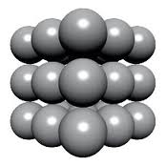
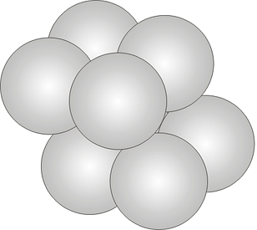
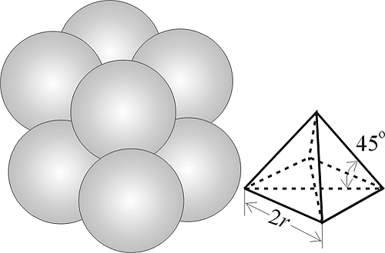
What does porosity depend on
Packing
Cubic/Hexagonal/Rhombohedral Packing – Calculate the porosity….
Cubic vs Hexagonal vs Rhombohedral
(47.65%) (39.5%) (25.95%)

Slide 29
What does porosity depend on
Porosity depends on Packing
Porosity DOES NOT depend on the size of the grains!!!

Slide 30
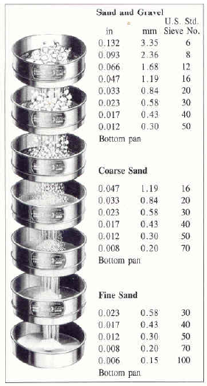
Grain Size Distribution
Very few materials have uniform grain sizes.
In order to measure the distribution of grains successively sieve materials through sieves of different size and build grain size distribution
Metrics – d₁₀ and d₆₀ (ten and sixty percentile diameters)
C_{U}=d₆₀/d₁₀ – coeff of uniformity
C_{U}<4 well sorted
C_{U}>6 poorly sorted
d10 is called effective grain size

Slide 31
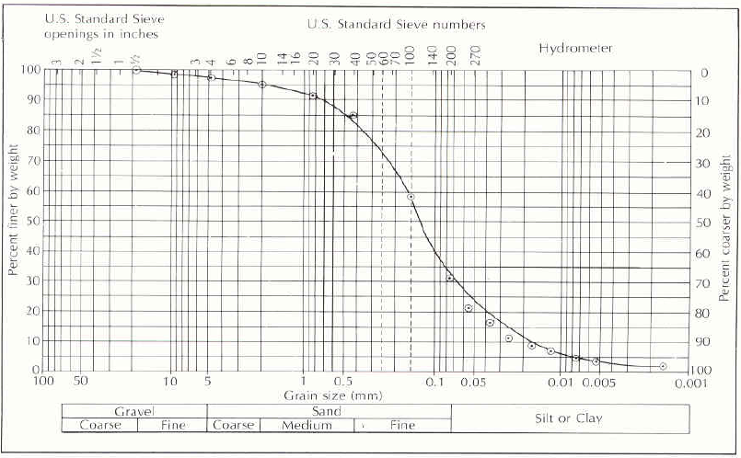
Typical GSD
d₆₀
d₁₀
GSD of silty fine to medium sand – What is C_{U}
Cu=d₆₀/d₁₀ (must be >1)

Slide 32
Specific Yield
Specific yield (Sy) is the ratio of the volume of water that drains from a saturated rock owing to the attraction of gravity to the total volume of the saturated aquifer.
Specific retention (Sr) is the rest of the water that is retained
Question: You have two materials with cubic packing; one is made up of small spheres, the other of larger ones; which has the larger specific retention? Think about the physics of what is retaining the water?

Slide 33
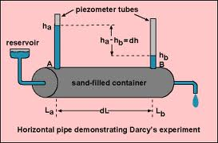
Hydraulic Conductivity
Measure flowrate Q to estimate specific discharge (velocity)
q=Q/Area
Observations

Slide 34
Darcy’s Law
Hydraulic Conductivity
Hydraulic Conductivity depends on both the
fluid and the porous medium

Slide 35
Further Observations
In a bed of packed beads the flow rate is proportional to the diameter squared
The flow rate is proportional to the specific weight of the fluid
The flow rate is inversely proportional to the viscosity of the fluid

Slide 36
Therefore
Property of the porous medium
only called intrinsic permeability
Denoted k_{i} with units m² (or Darcy’s)
1 Darcy=1x10⁻⁸cm²
What drives the flow
Property of the fluid only

Slide 37
Hazen Formula for Hydraulic Conductivity
C shape factor
Very fine sand: C=40-80
Fine sand: C=40-80
Medium sand: C=80-120
Coarse sand: C=80-120 (poorly sorted)
Coarse sand: C=120-50 (well sorted, clean)
Effective diameter d₁₀
Hazen proposed that hydraulic conductivity is given by
K=C (d₁₀)²
This is for water!!!!
C – shape factor (see adjacent table)
d₁₀ in cm
K is given in cm/s

Slide 38
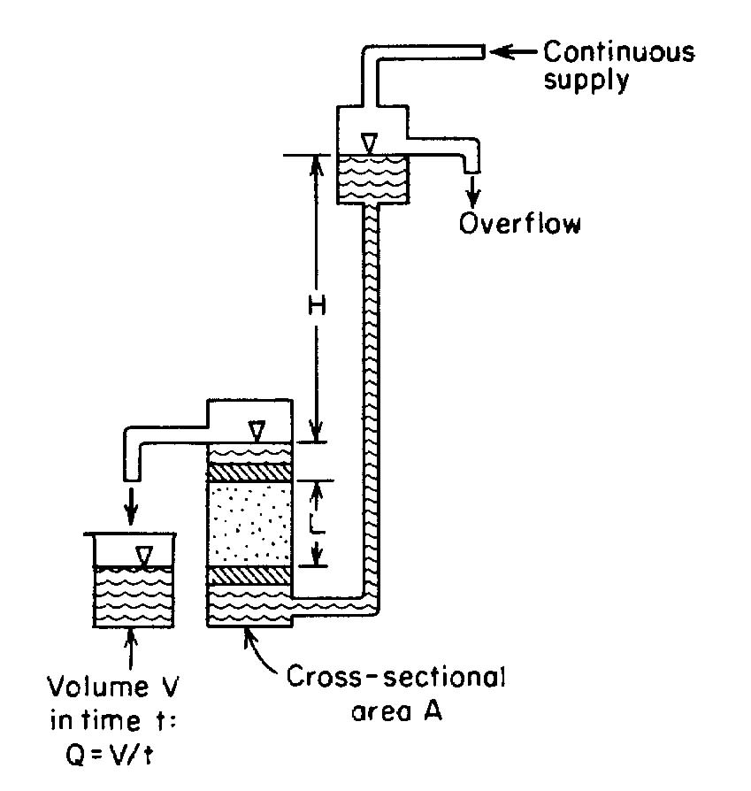
How to Measure Permeability
Measure Volume V over time t
Hydraulic Conductivity is given by

Slide 39
Transmissivity
We like to think about groundwater in 2-dimensions (like a map).
Therefore we like to define the permeability over the depth of the aquifer (depth b)
Tranmissivity
T=bK

Slide 40
More Generally
N parallel layers, each with conductivity K_{i} of thickness b_{i}
N perpendicular to flow layers, each with conductivity K_{i} of thickness b_{i}
K₁
K₁
K₂
K₃
K₄
K₂
K₃
K_{N}

Slide 41
Formally
Darcy’s Law
where
q is a vector
K is a symmetric tensor (matrix) K_{xy}=K_{yx}
is a vector

Slide 42
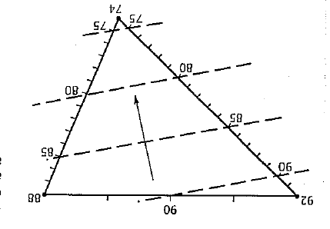
Hydraulic Gradient and Potentiometric Surface
3 well setup
Draw lines connecting wells
Note elevation at each well
Map distances between wells
Note difference in elevations
Find distance for unit head drop between wells
Mark even increments
Repeat for all well pairs
Create Contour Lines
Gradient normal to these lines

Slide 43
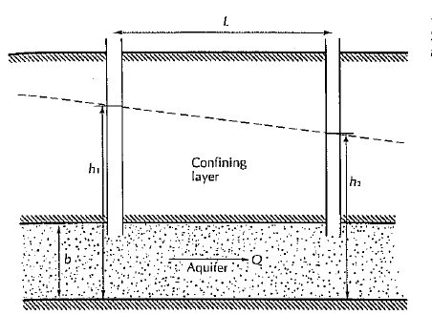
Steady Flow in Confined Aquifer

Slide 44
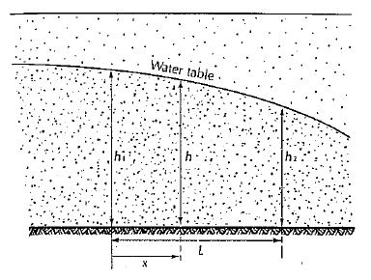
Steady Flow in an Unconfined A quifer

Slide 45
What about 2-d steady state
Confined
Unconfined
Direction of Flow (for both cases)
Recall that there are two angles that satisfy this equation. You must pick the correct one!
q_{y}
θ
q_{x}

Slide 46
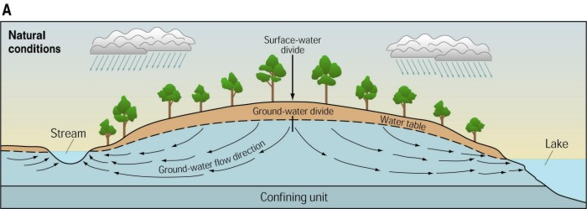
Groundwater Divides
Location of GW Divide is where q’=0

Slide 47
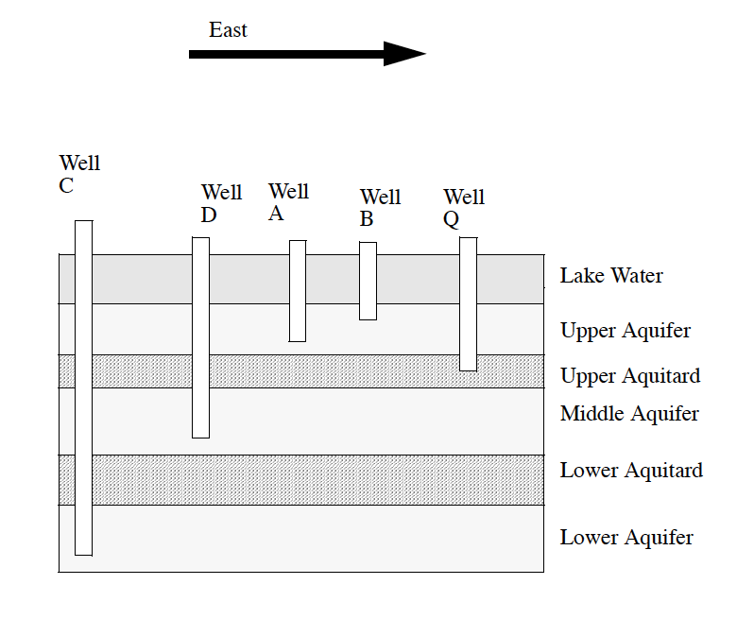
Final Test
If you were to compare the water levels in wells A and B, which well would have the higher water level?
How would you calculate the water level difference between A and B?
Which well has the higher water level, well A or Well Q?

